Slide 1

TP NET
Using a CNN approach to an optimized network for COVID-19 detection using XRAY images

Slide 2
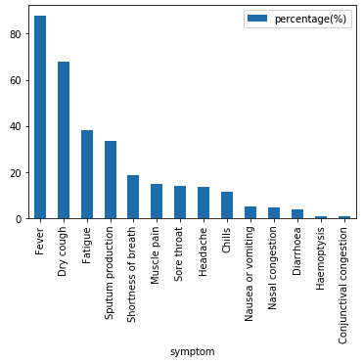
Current COVID-19 Scenario
Main symptoms of COVID-19

Slide 3
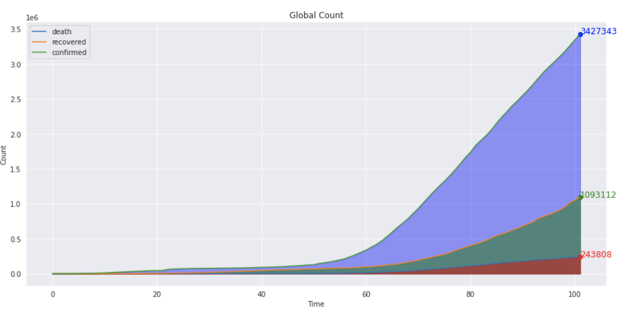
Current COVID-19 Scenario

Slide 4
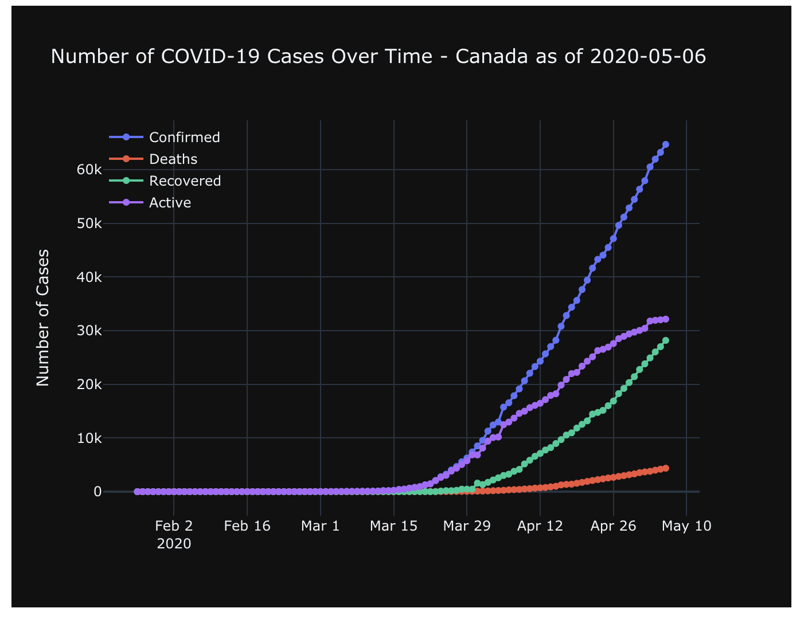
Current Scenario in Canada

Slide 5
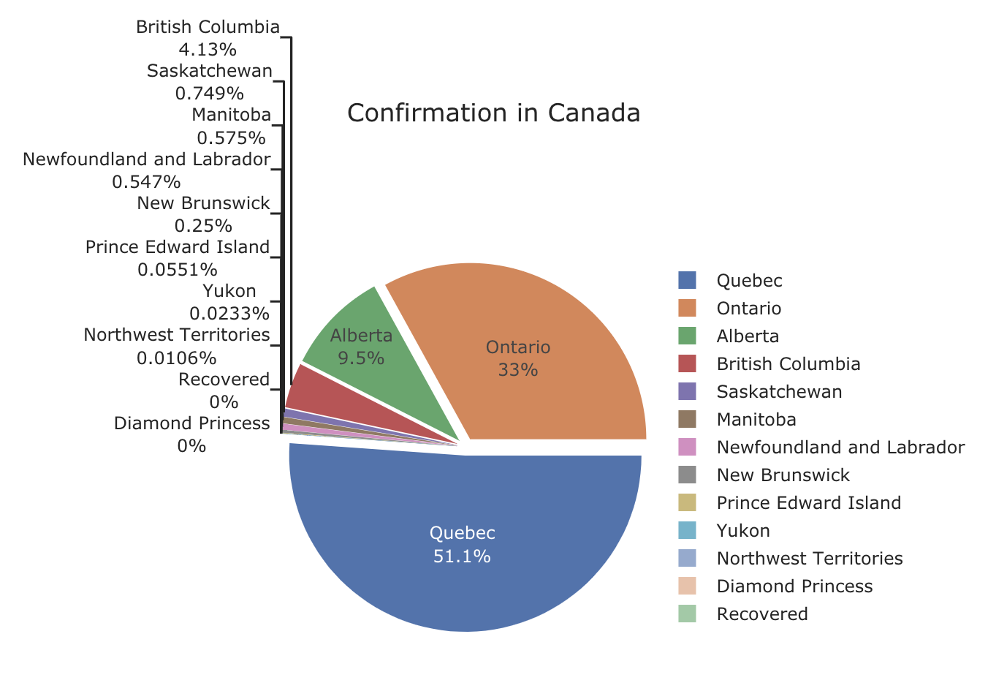
Canada Cases by Province

Slide 6
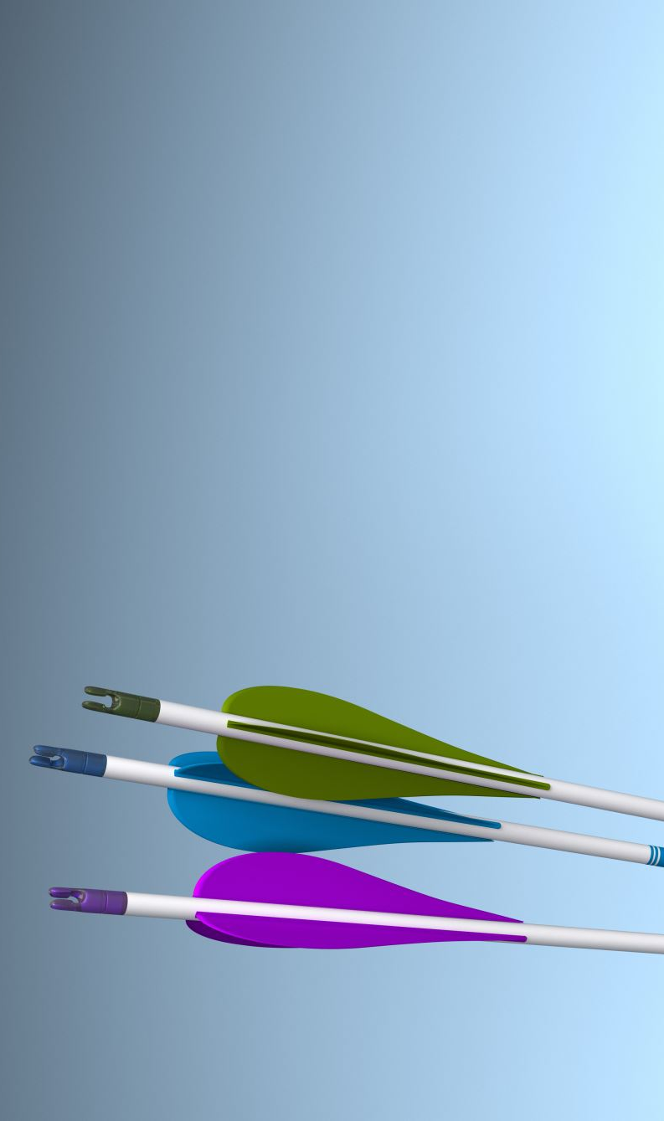
GOAL of Project
To identiify the trends in normal and COVID-19 patients using xray images

Slide 7
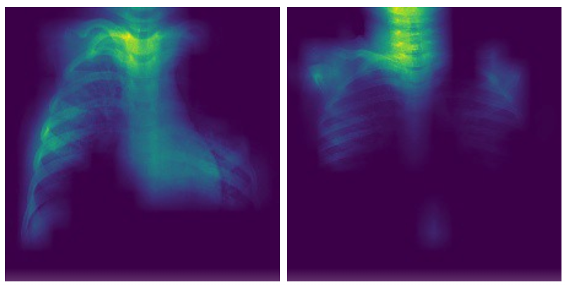
Normal Patients
Possible Outcomes

Slide 8
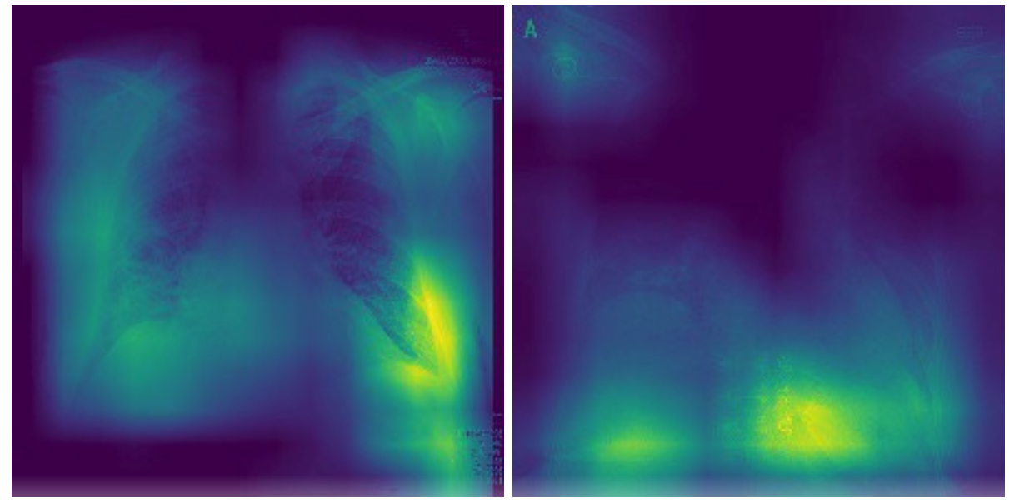
COVID-19 Patients
Heatmaps will show what the neural network is learning in the image of a COVID-19 patient and possible area of interest

Slide 9
Current Update
Doing Data Analysis to find trend using numbers of Covid-19 patients from John Hopkins Dataset.
Yet to apply GC Net and TP Net and evaluate the performance.
Yet to find the heatmap patterns in the data.
Found a way to implement CNN in the XRAY dataset images.
Do a data visualization for current situation in Canada vs the world in terms of death, recovery, active cases.

Slide 10
Challenges
Relatively small dataset
Need a good data preprocessing technique to overcome the issue.

